Slide 1
Some more on understanding regression
Shameek Bhattacharjee
Western Michigan University
This material was developed as part of NSF OAC 2017289

Slide 2
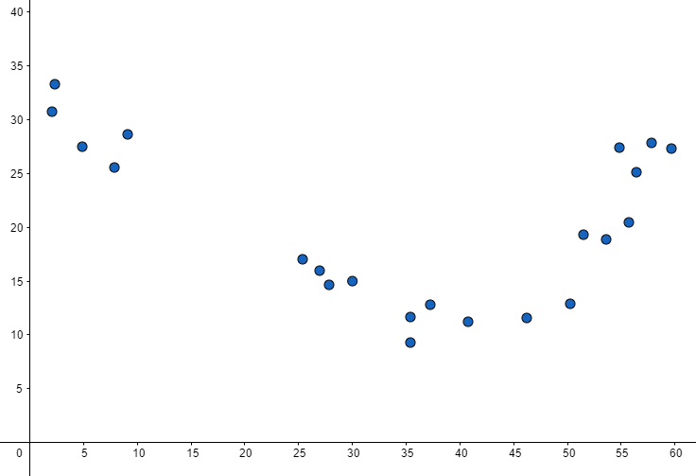
Bias-Variance Tradeoff, Something to be Aware of
Intuition Behind the Tradeoff
From the first slideshow, the assumption of normally distributed errors showed that if our model treats every point equally, the model may suffer from some bad predictions.
Similarly, if we introduce non-linear models that can be as flexible as we want, then there is a question asked: How flexible is too flexible?
When a model is fit too tight to any data, this is called Overfitting.
And when the model has a too loose fit to any data, then it’s called Underfitting.
Overfit(tight fit)
Underfit(loose fit)
The distribution of new data may be unknown.
Differing distributions between the training data and new data causes a tradeoff relationship to form between
the bias and variance of the model whereas one increases,
the other decreases. The Bias-Variance Tradeoff is the struggle of ML models to balance its bias and variance.
Balanced

Slide 3
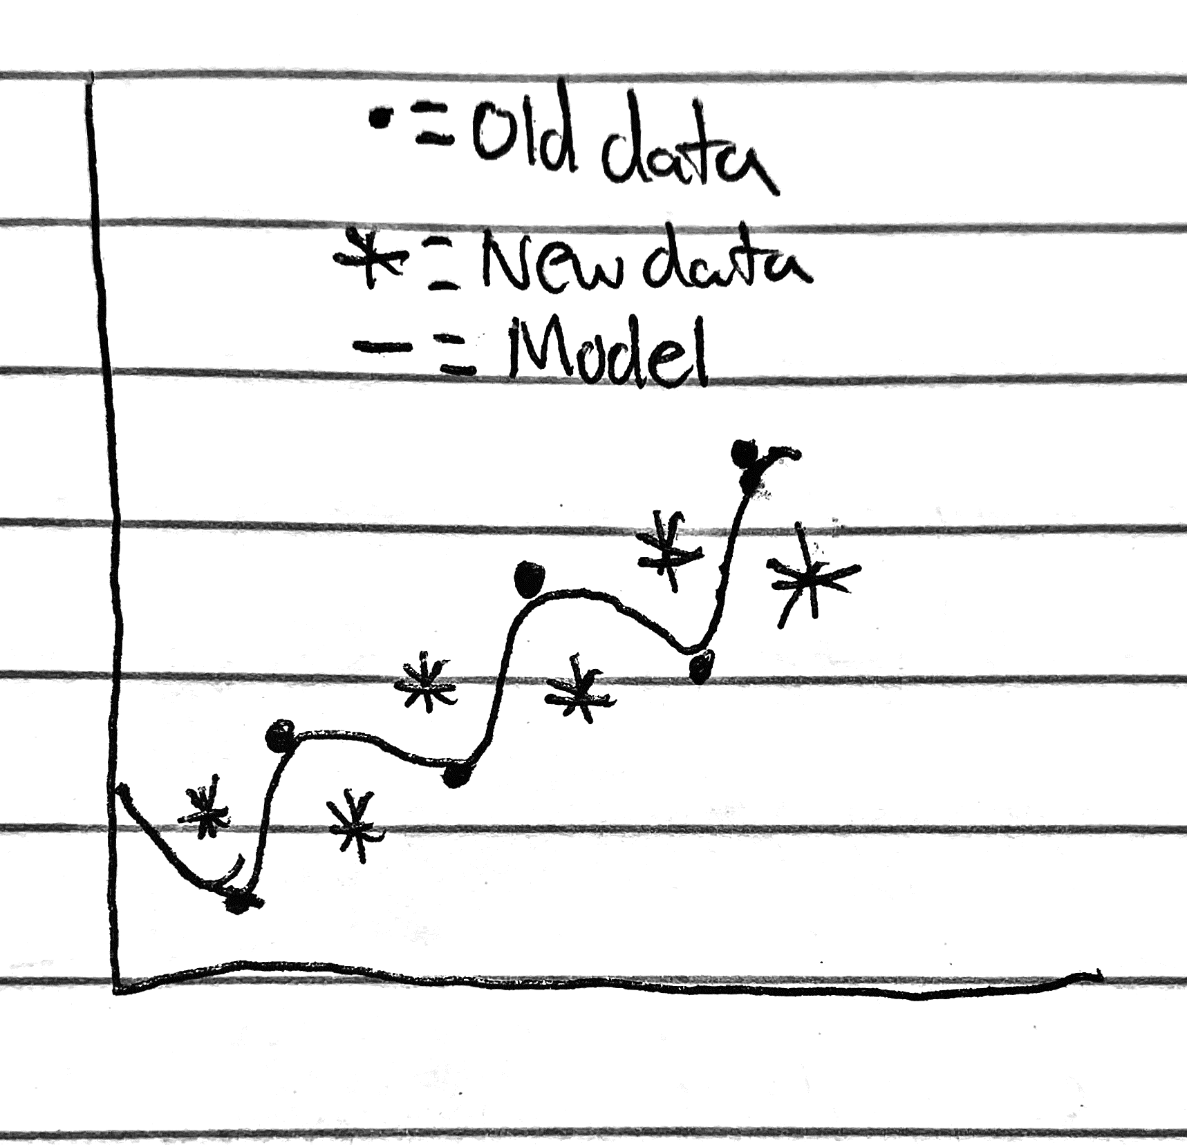
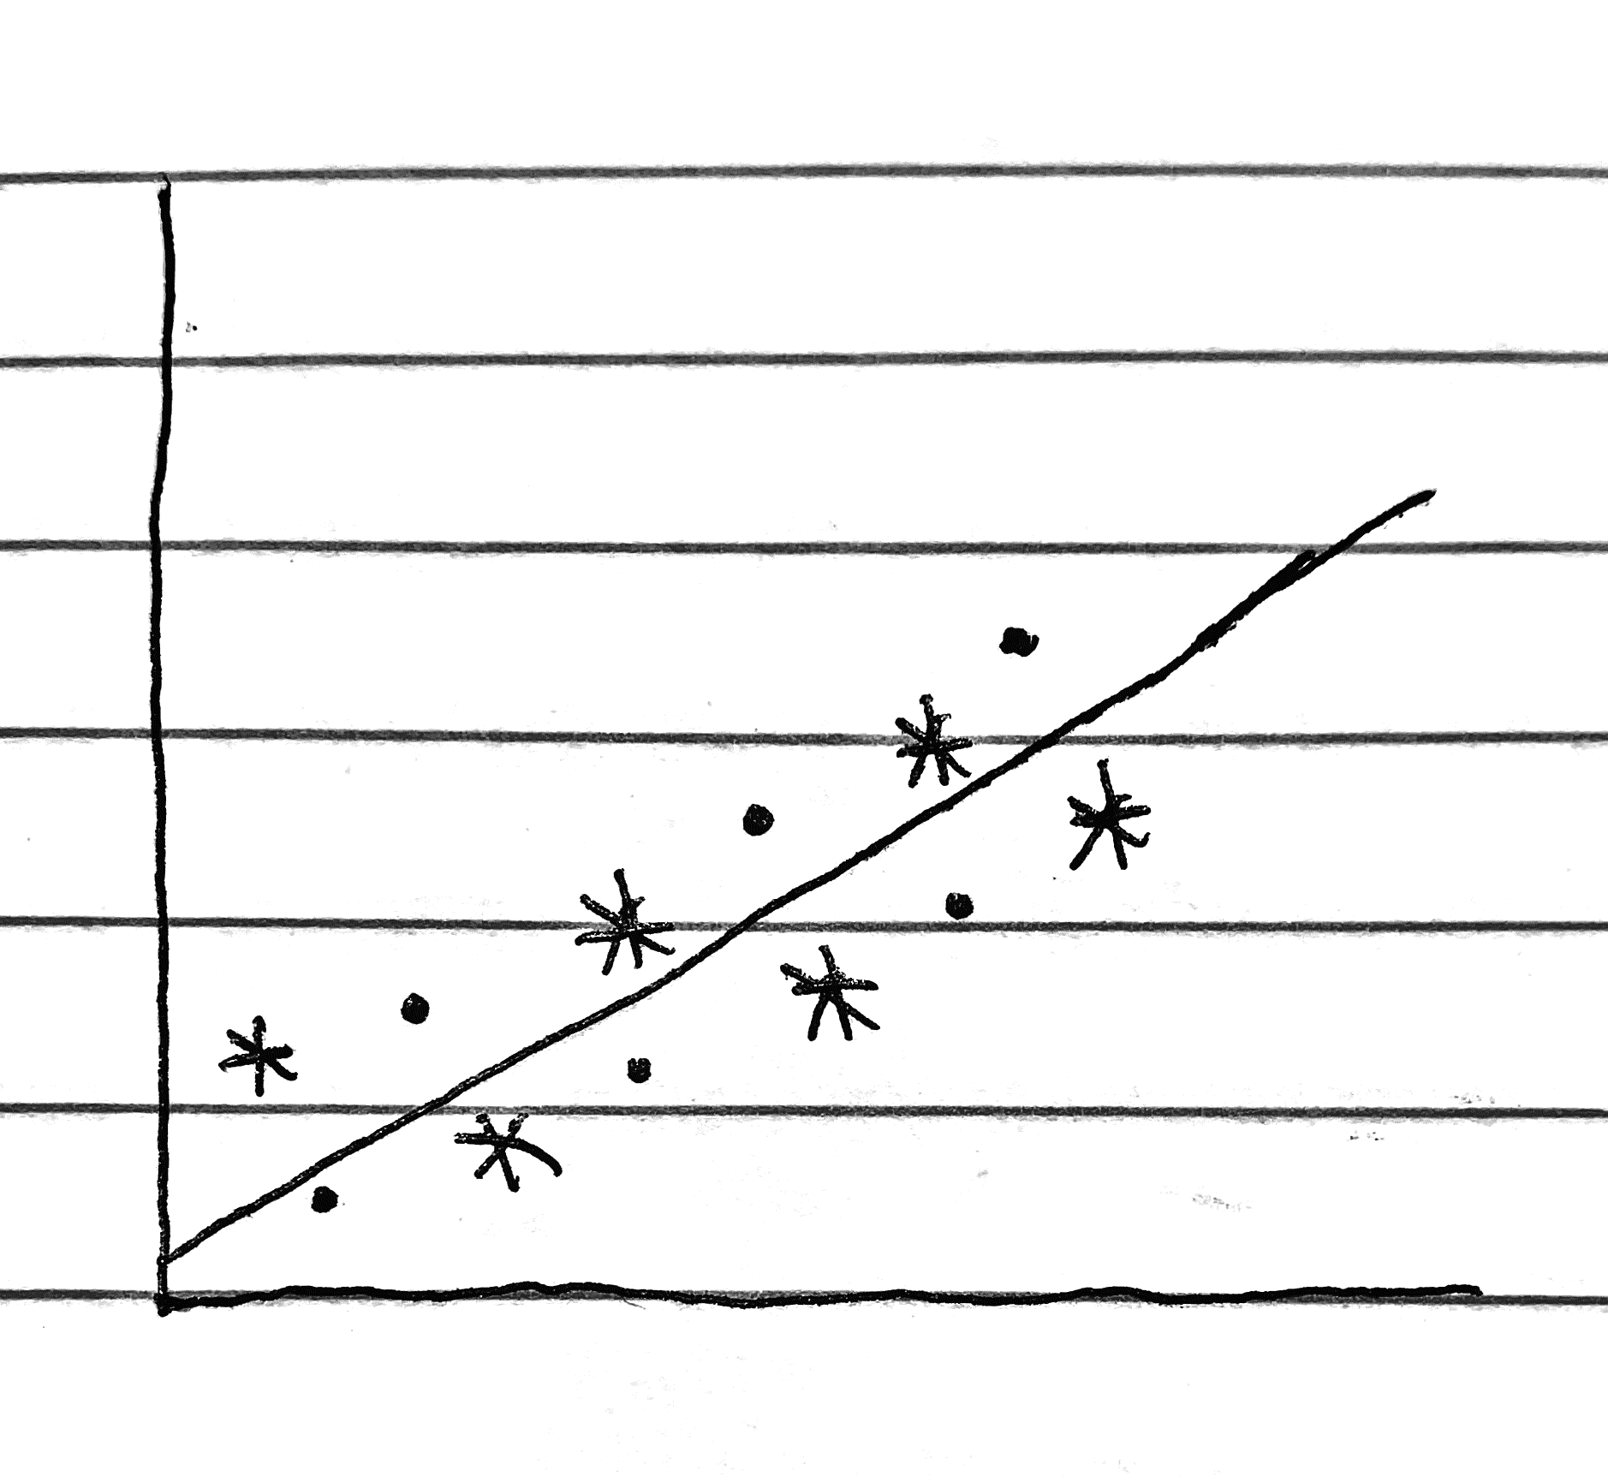
Problem with ML, Bias-Variance Tradeoff
If we use ML models to predict outcomes of new data, our models will assume the distribution of the new data is the same as the initial data. THIS IS PROBLEMATIC!
The Bias is the measurement of how tight our model fits our initial data.
Low Bias = Tight fit
High Bias = Loose fit
The Variance is the measurement of how tight our model fits our new data.
Low Variance = Tight fit
High Variance = Loose Fit
The Bias-Variance Tradeoff is the struggle of ML models to balance its bias with its variance.
(Model shows low bias and high variance)
(New model finds a middle ground between its bias and variance)

Slide 4
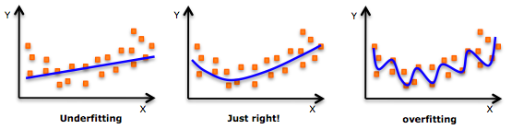
Overfitting vs Underfitting
Having the knowledge of bias and variance helps us to understand what an Overfit and Underfit model are.
An Underfit model is one that follows a very lenient fit to the initial data, hence having high bias.
An Overfit model is one that follows a strict fit to the initial data, giving a low bias
The Bias-Variance tradeoff is directly synonymous with these ML model patterns.
To find a balance between each of these things, we use Regularization techniques to adjust our models.

Slide 5
BIAS
The relative (in-)ability of a model to fit the training data is called the Bias.
Higher bias means the model has a loos(-er) fit to the training data
Low Bias means the model has a tighter fit to the training data.
(ok I want this ! it explains the seen data well)
VARIANCE
The relative ability of our trained model to match the new unseen data (in the test set) is called the Variance.
Low variance means a tighter match between trained model (my prediction) and new data (the actual observations/ground truth) → [desirable we want this]
High variance means a looser fit or gap between my prediction and new unseen data → [epic FAIL !!! We do not want this lousy prediction]
Eternal Dilemma of ML
Too low bias often leads to high variance→ because there may be some difference in the underlying structure of the data collected during training and the data experienced during the ML method’s deployment

Slide 6
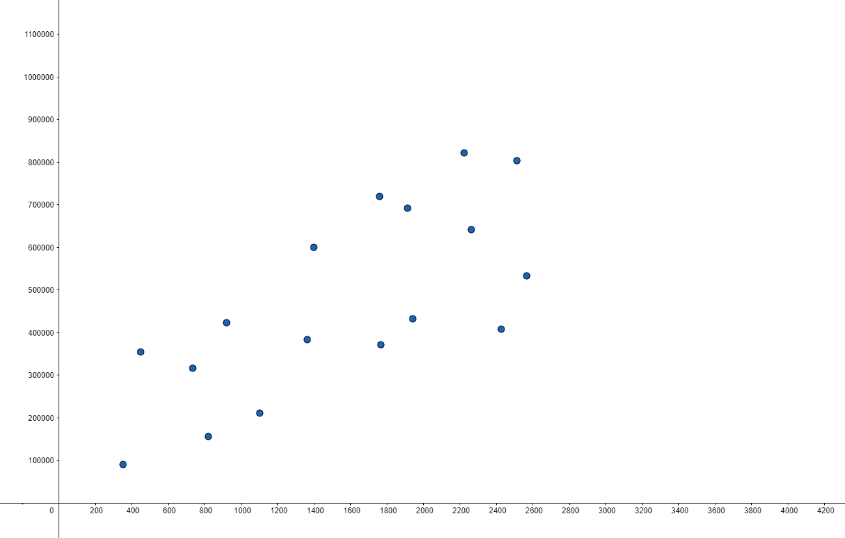
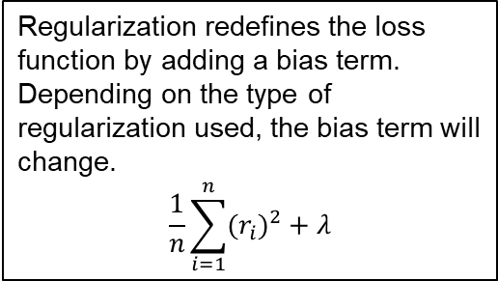
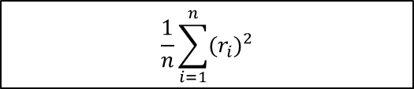
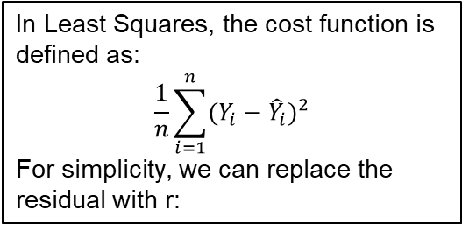
Example of Bias-Variance Concern
In Least Squares, the cost function is defined as:
$$\frac{1}{n}\sum_{i=1}^{n}{{(Y_{i}−{\hat{Y}}_{i})}^{2}}$$
For simplicity, we can replace the residual with r:
In order to mitigate risk of overfitting to the housing data from city A, Regularization is a tool that increases a models bias with intention of decreasing its variance, making our model more agile to a differing distribution in city B.
A linear model has been shown to be a good fit to this data.
$$\frac{1}{n}\sum_{i=1}^{n}{{(r_{i})}^{2}}$$
Price
Now, say this data comes from city A, and we want to use our model to predict city B. The distribution of housing data in city B may or may not be like that of city A.
Regularization redefines the loss function by adding a bias term. Depending on the type of regularization used, the bias term will change.
$$\frac{1}{n}\sum_{i=1}^{n}{{(r_{i})}^{2}}+λ$$
Size in Square Feet

Slide 7
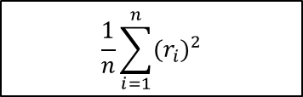


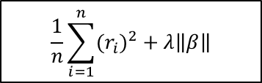


Regularization, A Method of balancing Bias and Variance
There are multiple methods of Regularization, each with different bias terms. These are three main ones:
Ridge
$$\frac{1}{n}\sum_{i=1}^{n}{{(r_{i})}^{2}}+λ{\left\|β\right\|}^{2}$$
Lasso
$$\frac{1}{n}\sum_{i=1}^{n}{{(r_{i})}^{2}}+λ\left\|β\right\|$$
Elastic Net
$$\frac{1}{n}\sum_{i=1}^{n}{{(r_{i})}^{2}}+λ{\left\|β\right\|}^{2}+λ\left\|β\right\|$$
In Least Squares, the cost function is defined as:
$$\frac{1}{n}\sum_{i=1}^{n}{{(Y_{i}−{\hat{Y}}_{i})}^{2}}$$
For simplicity, we can replace the residual with r:
Lambda($λ$) acts as a constant value that we set. This is also known as a Hyperparameter since the value is explicitly specified. Beta($β$) value can be substituted with any parameter of interest.
An important limitation of Regularization is in the presence of too much noise/outliers, this will cause these methods to not work.
Another important thing to remember is that since Lambda is a hyperparameter, we have to define its value. If our test data is not readily available, then Cross-validation can help us make the best estimate of this.
Still using Least Squares to deduce the best fitting model, the empirical risk of each model is now defined differently, which will cause the best model to not fit the data as well as before, hence we have added bias.
$$\frac{1}{n}\sum_{i=1}^{n}{{(r_{i})}^{2}}+λ\left\|β\right\|$$
$$\frac{1}{n}\sum_{i=1}^{n}{{(r_{i})}^{2}}$$
Regularization redefines the cost function by adding a bias term:
$$\frac{1}{n}\sum_{i=1}^{n}{{(r_{i})}^{2}}+λ\left\|β\right\|$$

Slide 8
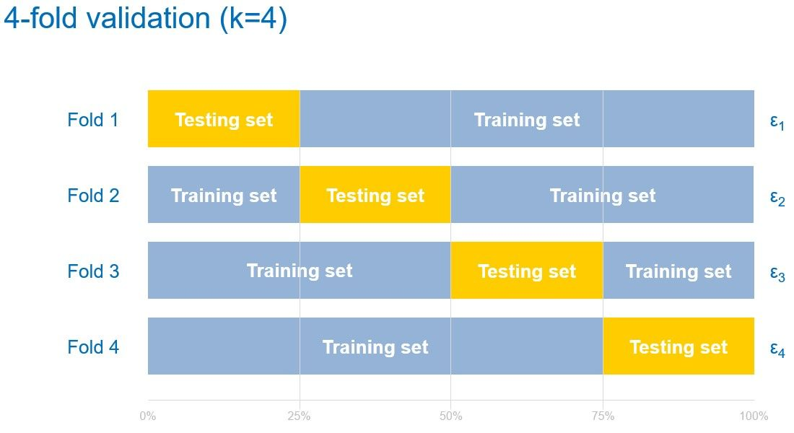
Cross Validation for Hyperparameter tuning
The Process
This process involves randomly splitting the available data into (k) equally-sized chunks and using one chunk as the test data and fitting a model to the rest of the data. This will be repeated (k) number of times, each time with a different chunk of data designated as the test set.
For each (k) iteration, the fitted model will use a wide range of values for the hyperparameter/s of interest. The best performing value for that hyperparameter will be recorded.
The concluding hyperparameter will be the average of the (k) number of best performing hyperparameters. Using this process in regularization, a variety of different Lambda values are tried to estimate an optimal value.
Modern programming languages have CV available.
10-fold, 5-fold, and (n-1)-fold CV are the most common routes, but the more folds, the more computationally intensive the process becomes.

Slide 9
Conclusion
Delicate balance of bias and variance are important to keep predictions reliable between small shifts between training and test
However, regularization has its limits and will not work if there are problems (errors, bad data, attacks) inside your training data itself
Several alternatives are there to improve robustness of regression learning of parameters
One such idea is M-estimation which we will see in a later module

